Slide 1
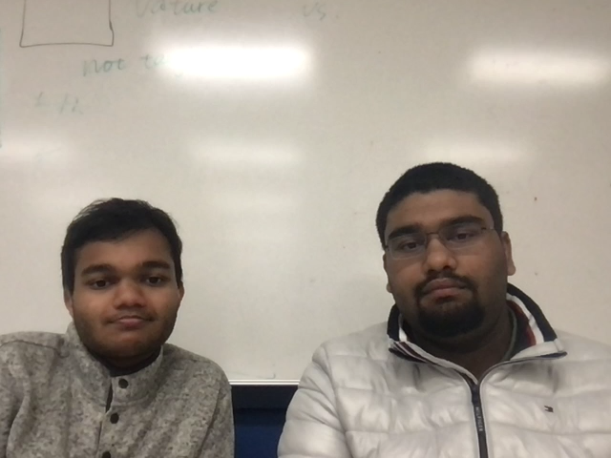
Coterie
A Place To Find Your People
Promoting In-person Socialization In The Post-COVID World

Slide 2
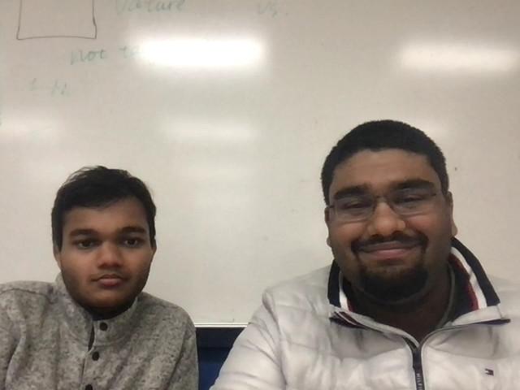
Mission
In-person socialization through personalized connections in the post-COVID world.

Slide 3
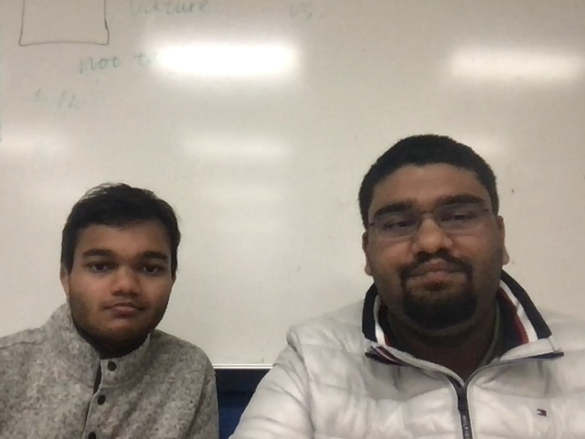
Vision
Empower individuals to make connections based on shared interests
Thorough evaluation of an individual’s interest profile by looking beyond perceivable factors

Slide 4



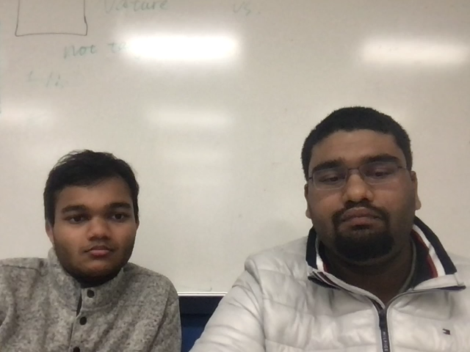
Login
Login
Register

Slide 5



Interest
Profile
John Doe
mail@google.com
Interests
Movies
Tech
…
Music
…
…

Slide 6


Find
People
Activity
Active Matches 4
Outgoing Matches 3
Incoming Matches 2
People
John Doe
Joh
Tech News

Slide 7



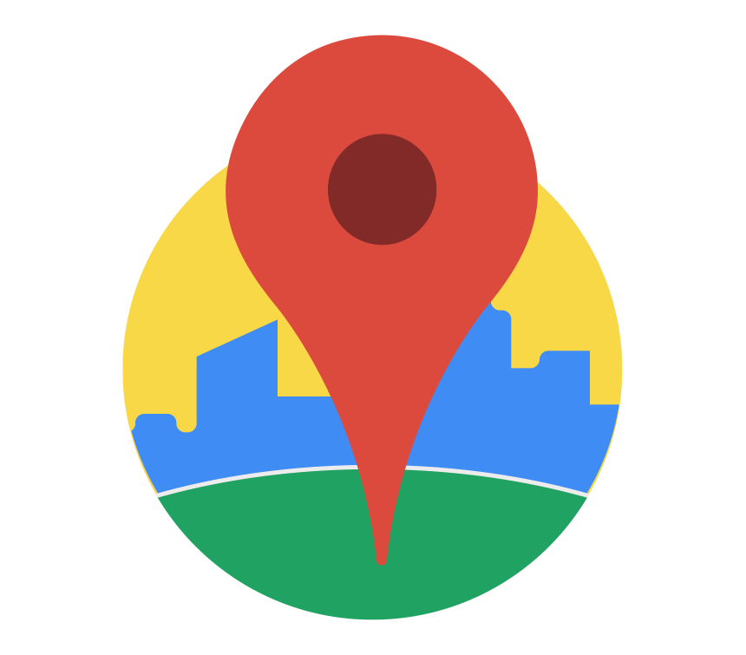

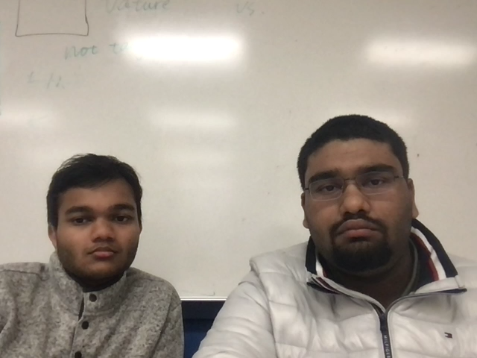

Tech Stack
faiss

Slide 8
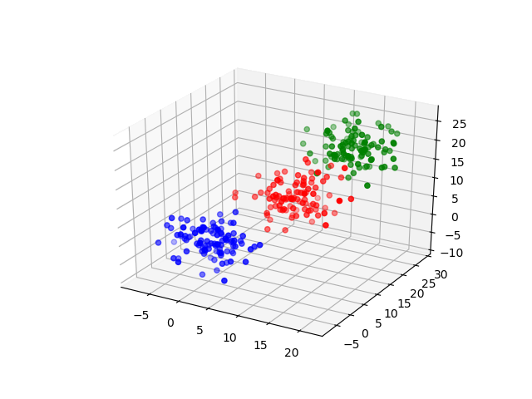
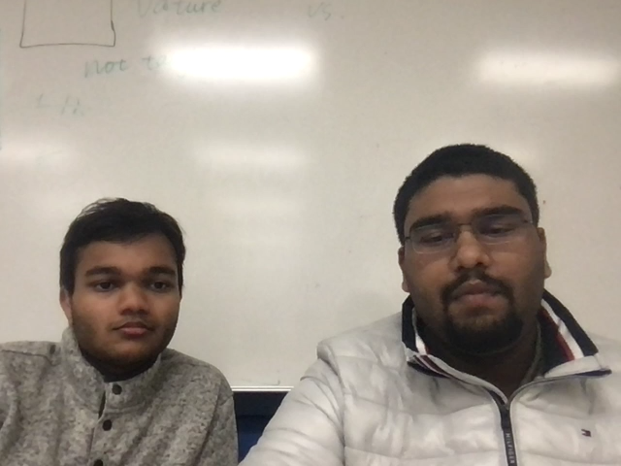
Tech Stack
K-Means
Clustering
Education
Gaming
Sports

Slide 9
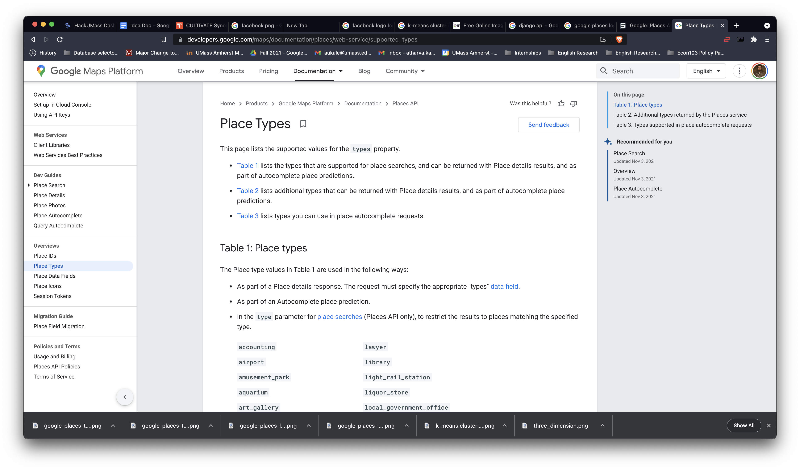
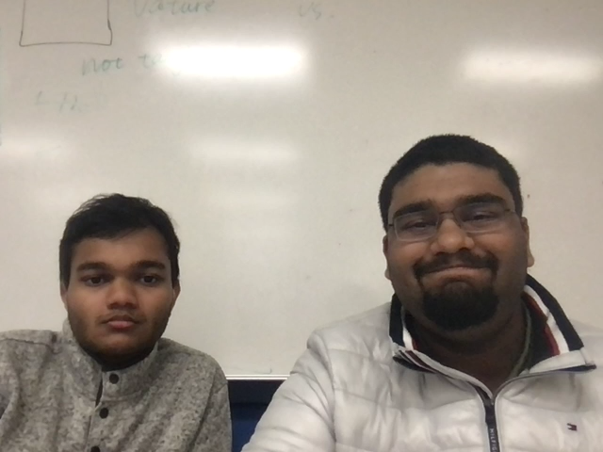
Tech Stack
Google
Places
API

Slide 10
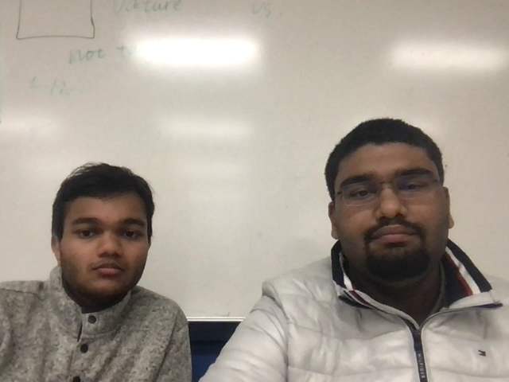
Coterie
A Place To Find Your People
Promoting In-person Socialization In The Post-COVID World

